Slide 1
Sampling Theorem & Antialiasing

Slide 2
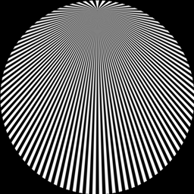
Motivations
“My ray traced images have a lot more pixels than the TV screen. Why do they look like @#$%?”
How to compute the pixel colors for the following pattern?
Antialiasing with Line Samples
Rendering Techniques '00 (Proceedings of the 11th Eurographics Workshop on Rendering), pp. 197-205
Thouis R. Jones, Ronald N. Perry

Slide 3
Part I: Sampling Theorem

Slide 4
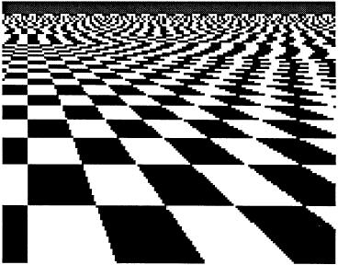
Example of Aliasing in Computer Graphics

Slide 5
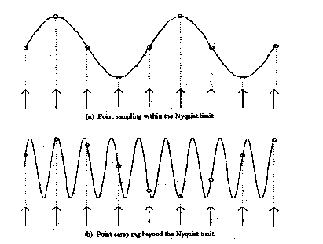
Examples of Aliasing in 1D
See Figure 14.2 (p.394) of Watt’s book for other examples.

Slide 6
An Intuition –
Using a Single Frequency
It’s easy to figure out for a sin wave.
What about any signal (usually a mixture of multiple frequencies)?
Enter Fourier Transform…

Slide 7
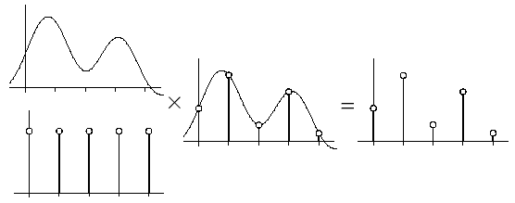
Sampling
1D Signal: x → f(x) becomes i → f(i)
2D Image: x, y → f(x, y)
  For grayscale image, f(x, y) is the intensity of pixel at (x, y).

Slide 8
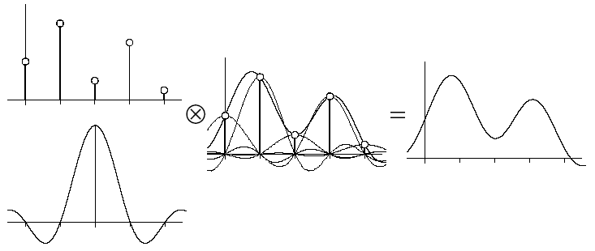
Reconstruction
If the samples are “dense” enough, then we can recover the original signal.
Question is: How dense is enough?

Slide 9
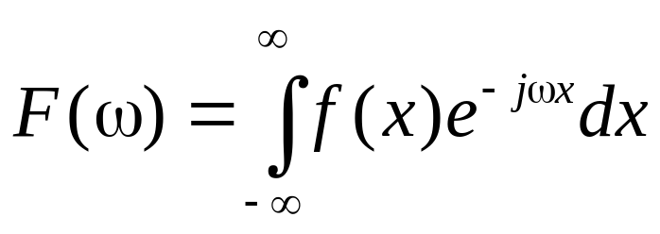
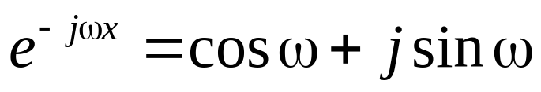
Fourier Transform
Can we separate signal into a set of signals of single frequencies?
t
ω
ω

Slide 10
Square Wave
Even a square-shape wave can be represented by the sum of a series of sin or cos functions
See
  https://bl.ocks.org/jinroh/7524988
  https://youtu.be/LznjC4Lo7lE
  http://blog.xuite.net/lapuda.chen/PaulBlog/221866406
© Chun-Fa Chang

Slide 11
Basis Functions
An example:
  X=[x₁, x₂, …, x_{n}]
  U=[u₁, u₂, …, u_{n}]
  V=[v₁, v₂, …, v_{n}]
  Let X = a*U + b*V, how to find a and b?
If U and V are orthogonal, then a and b are the projection of X onto U and V.

Slide 12
Compared to Fourier Transform
Consider a continuous signal as a infinite-dimensional vector
  [ f(ε), f(2ε), f(3ε),….. ]
Consider each frequency ω a basis, then F(ω) is the projection of f(x) onto that basis.
t

Slide 13
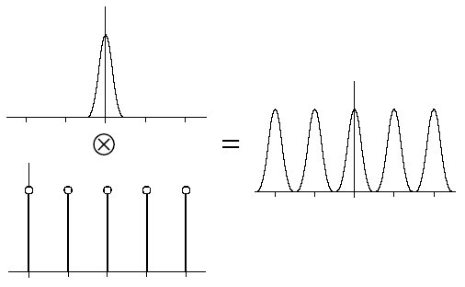
Sampling
Spatial domain: multiply with a pulse train.
Frequency domain: convolution!

Slide 14
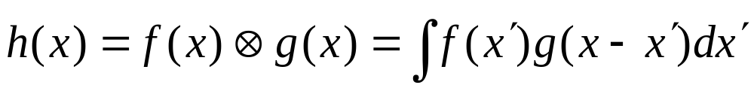
Convolution
To start with, image that f(x) is nonzero only in the range of [-a, a].
  Then we only need to consider g(x) in the range of [x-a, x+a]
Multiplication in spatial domain results in convolution in frequency domain (and vice versa).

Slide 15
Exercise
How wet is the ground at x after rain, assuming rain drops fall at f(x) and spread like g(x)?

Slide 16
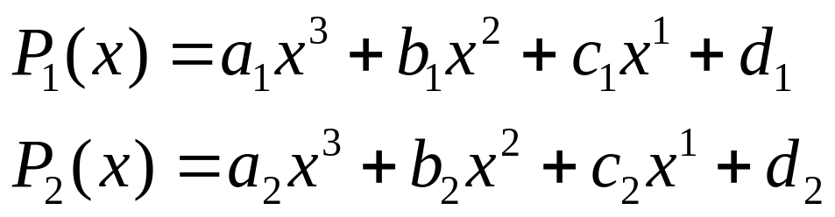
An Intuition for Convolution
Does it make sense to you that multiplication in one domain becomes convolution in the other domain?
Look at this example:
What are the coefficients of P₁*P₂?

Slide 17
Consider x^{n}, …, x², x¹, x ⁰ as basis.
Projections of P1 and P2 to the basis are (a₁, b₁, c₁, d₁) and (a₂, b₂, c₂, d₂)
P1(x)*P2(x) results in: (a₁, b₁, c₁, d₁) ⊗ (a₂, b₂, c₂, d₂) in the transformed space.

Slide 18
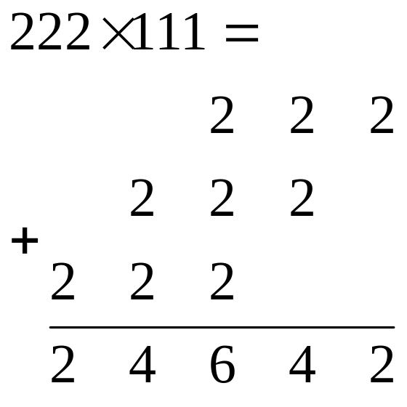
The fact is: you have been doing convolution since elementary school!
Example: 222*111 is computed as (2,2,2) ⊗ (1,1,1)

Slide 19
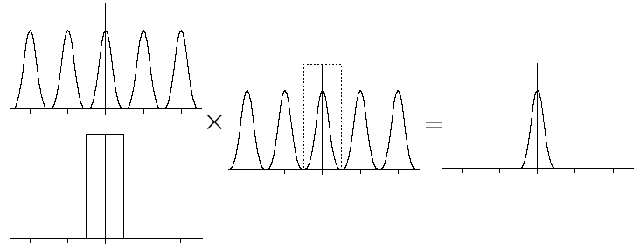
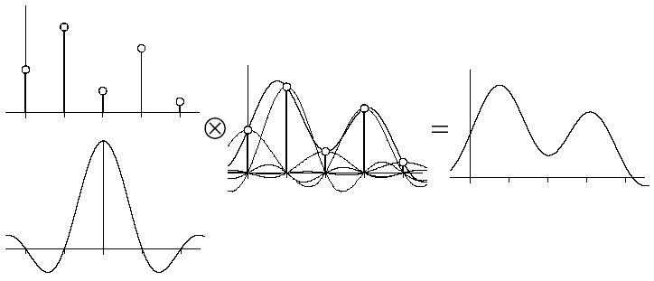
Reconstruction
Frequency domain:
Spatial domain: convolve with Sinc function

Slide 20
Reconstruction Kernel
For perfect reconstruction, we need to convolve with the sinc function.
  It’s the Fourier transform of the box function.
  It has infinite “support”
May be approximated by Gaussian, cubic, or even triangle “tent” function.

Slide 21
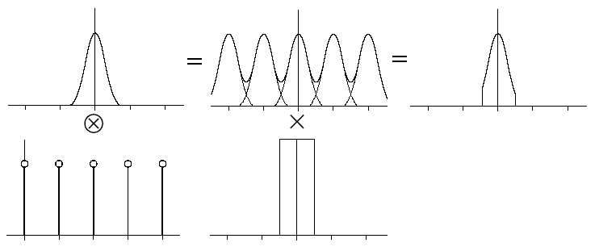
Nyquist Limit
Nyquist Limit = 2 * max_frequency
Undersampling: sampling below the Nyquist Limit.

Slide 22
Part II: Antialiasing

Slide 23

Changes within a Pixel
A lot can change within a pixel:
  Shading
  Edge
  Texture
Point sampling at the center often produces undesirable result.

Slide 24
Pixel Coverage
What should be the pixel colors for these?
Can we simply use the covered areas of blue and white? (Hint: convolve with box filter.)
Do we have enough data to compute the coverage?

Slide 25
Antialiasing
Consider a ray tracer. Is it often impossible to find the partial coverage of an edge.
Each ray is a point sample.
We may use many samples for each pixel → slower performance.

Slide 26
Antialiasing – Uniform Sampling
Also called supersampling
Wasteful if not much changes within a pixel.

Slide 27
Filtering
How do we reduce NxN supersamples into a pixel?
  Average?
  More weight near the center?
Let’s resort to the sampling theorem.

Slide 28
Reconstruction
Frequency domain:
Spatial domain:

Slide 29
A Few Observations
In theory, a sample influences not only its pixel, but also every pixels in the image.
What does it mean by removing high frequencies?

Slide 30
Other Than Uniform Sampling?
So far, the extra samples are taken uniformly in screen space.
Other ways to take extra samples:
  Adaptive sampling
  Stochastic (or randomized) sampling

Slide 31
Antialiasing – Adaptive Sampling
Feasible in software, but difficult to implement in hardware.
Increase samples only if necessary.
But how do we know when is “necessary”?
  Check the neighbors.

Slide 32
Antialiasing – Stochastic Sampling
Keep the same number of samples per pixel.
Replace the aliasing effects with noise that is easier to ignore.

Slide 33
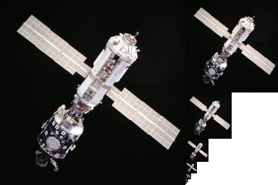
Mipmap – Antialiasing for Texture Mapping
When we reduce a 2Nx2N texture into a NxN texture for the next level of mipmapping, we are doing the filtering (usually by bilinear filtering).
Trilinear filtering: If the most suitable texture is between NxN and 2Nx2N, then access texels from both levels, and then interpolate.
Note that the filtering is
isotropic (vs. anisotropic),
meaning the filtering is done
on a square (or a circle).
From: http://commons.wikimedia.org/wiki/File:MipMap_Example_STS101.jpg

Slide 34
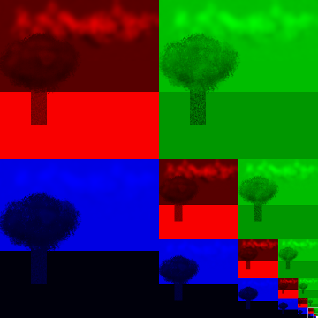
Mipmapping in RGB Color
By Phorgan1 (talk) 00:34, 5 February 2012 (UTC) Illustration by me, Patrick Horgan made available freely under a Creative Commons license. - http://en.wikipedia.org/wiki/File:, CC BY-SA 3.0, https://commons.wikimedia.org/w/index.php?curid=27311755

Slide 35
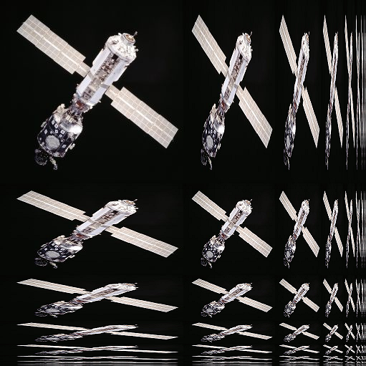
Anisotropic Mipmap
From: http://commons.wikimedia.org/wiki/File:MipMap_Example_STS101_Anisotropic.png

Slide 36
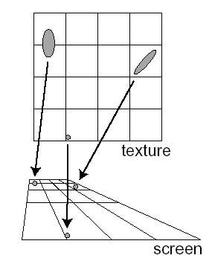
EWA for Texture Mapping
Paul Heckbert, “Survey of Texture Mapping” IEEE CG&A, Nov. 1986. (Figures)
Green & Heckbert, “Creating Raster Omnimax Images from Multiple Perspective Views Using The Elliptical Weighted Average Filter” IEEE CG&A, 6(6), pp. 21-27, June 1986.

